Slide 1

Better Than Dialogue Trees
Presented by ALMOST HUMAN
Project Horseshoe 2017
(Click to proceed)

Slide 2
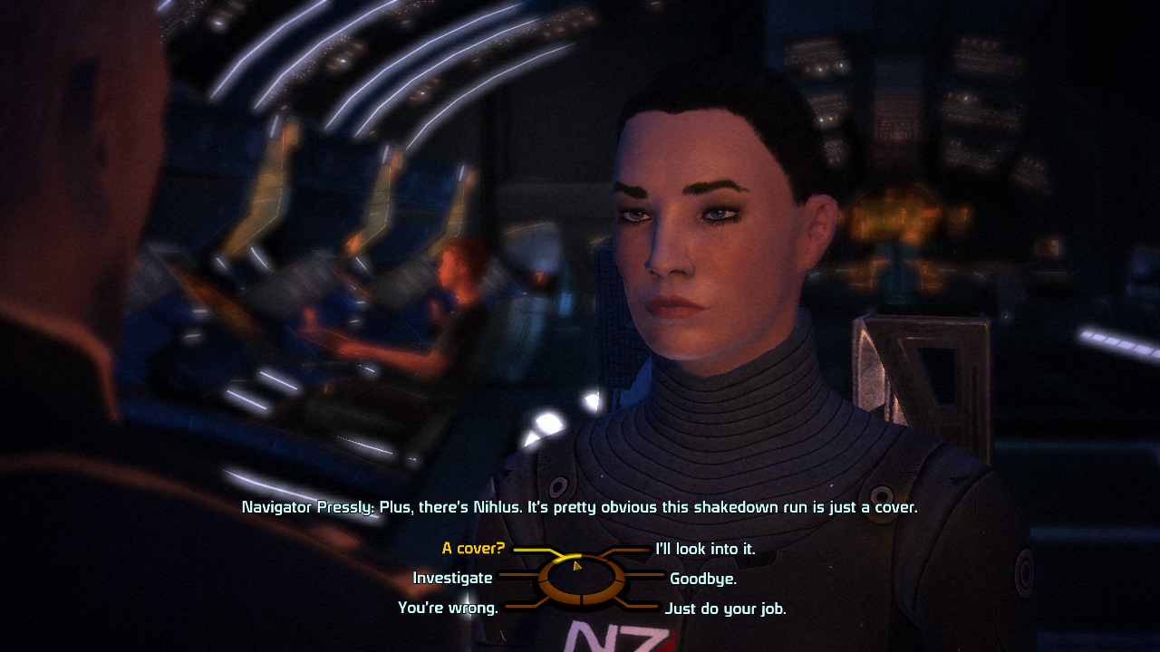
In This Document
ALMOST HUMAN: Dialogue trees have been in games for 30 years now, but they have significant limitations. We seek ways to interact with NPCs in a more human way.
WHO wrote this?
HOW do we design better dialogue systems?
WHAT is the purpose of the dialogue trees?
WHICH games provide useful case studies?
WHY do they fail to fulfill their purpose?
WHERE can we find better tools for dialogue?

Slide 3


Authors:
Ian Schreiber (Rochester Institute of Technology)
Wendy Despain (SMU Guildhall)
Trey Alsup (Wishcraft Simulations)
Jonathan Hamel (Ready at Dawn)
Ethan Ham (Bradley University)
Jason VandenBerghe (ArenaNet)
Yuri Bialoskursky (Electronic Arts)
Jerry Belich (Miami University)
Workgroup Facilitator:
Jeff Pobst (Hidden Path Entertainment)
Special Thanks:
Jake Forbes (Star Stable Entertainment)

Slide 4
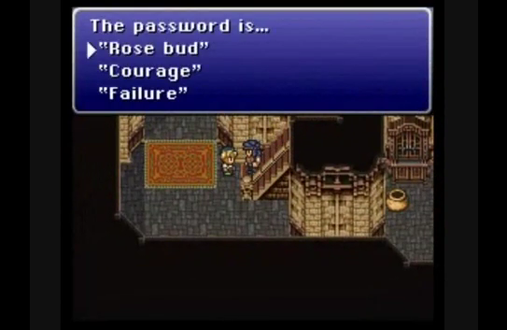
Why talk to NPC’s?
Narrative agency: player defines the story
Self-expression: let the player define who the PC is (Mass Effect)
Character exposition: PC/NPC Self expression (Firewatch)
Relationship building: friend networks with NPCs (Dragon Age)
Rewards: information, humor, etc. (Monkey Island)
Puzzles: Conversation as puzzle (Planescape: Torment)

Slide 5
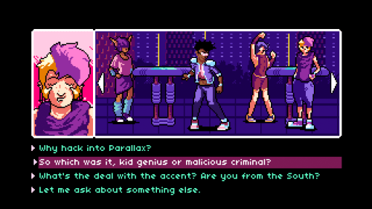
Why have we used dialogue trees?
    Transactions with NPCs (shopkeepers, etc.)
    Giving the player agency (or illusion of agency) over the narrative
    Better ratio of dev time to play time than alternatives like FMV cut scenes or conversational AI
    Automated substitute for GM-controlled NPCs or Charisma rolls in tabletop RPGs
    Practical way to break a giant wall of text into smaller, easily-readable chunks
    Adds interactivity to an otherwise non-interactive part of the game
    Efficient way to let the player explore the parts of the story they want and ignore the rest (like an HTML doc where the reader can click on links of interest)
    Lets completionist players explore all options without them having the fear of missing out that a more open conversation system gives
    Meets audience expectations

Slide 6
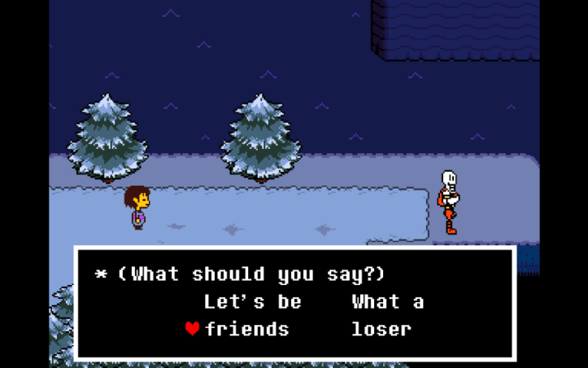
* Why do so many of us hate dialogue trees, then?
NPCs have no agency. They respond in pre-programmed NPCs end up feeling like vending machines where
ways that are often easy to master. This makes them feel the player pushes a button to get a response out of
like marionettes where the player is pulling the strings, it. Real human interaction doesn’t work like that.
which destroys the illusion of interacting with another Real interactions involve uncertainty and consent,
character. something that NPCs don’t have, which makes the interaction feel awkward.

Slide 7
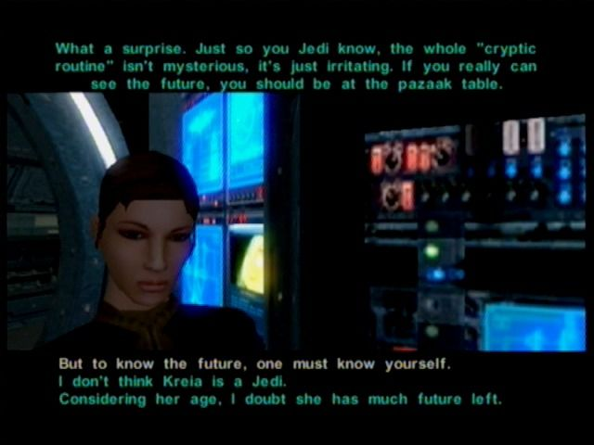
Are there other reasons dialogue trees fail to engage players?
If a player can choose any option, the PC might not have a consistent perspective, thus becoming a weak character.
There’s often a mismatch between the conversation and other core systems; dialogue trees may not support the core gameplay.
Sometimes the player wants to say something that isn’t available as an option, which breaks immersion.
Sometimes the player chooses an option expecting one thing, and then the option plays out contrary to player intention, leading to frustration.
If there is a “right” answer among the dialogue options, the player’s focus shifts from having a conversation to solving a puzzle, which becomes an obstacle to immersion.

Slide 8
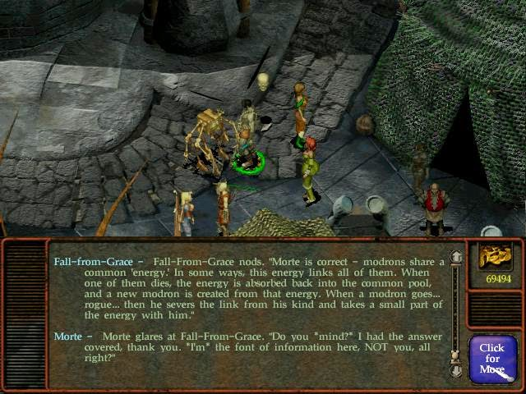

Some dialogue trees feel artificial because there’s no conversational history or context: within a single conversation, selecting the same option will give the same result every time. This presentation is an example: if you ask about what’s wrong with dialogue trees, you’ll get the same sequence of slides no matter how many times you asked before. In an actual conversation, asking the same thing multiple times or asking things out of order (such as offering a greeting only after conducting business) would come across as strange, but NPCs don’t often look perturbed when this happens.

Slide 9
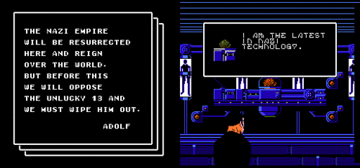
Also: dialogue in games exploits a brainhack often used by con artists as a shortcut to human intimacy and trust: volunteering some extremely personal piece of information early in a conversation to cause the other to reciprocate or take the cue that we must be close. This can be highly efficient for gamers used to this convention, but weird and off-putting for players who aren’t.

Slide 10
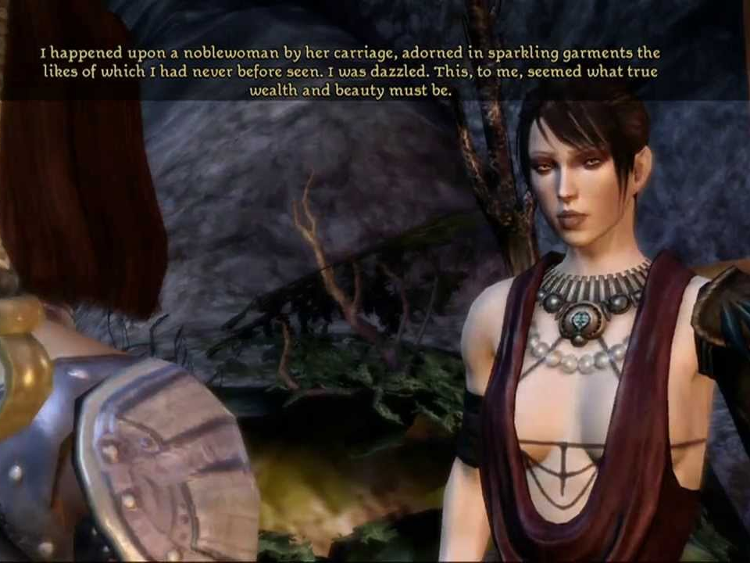
The greater the sense that a player can “win” a conversation – such as gameplay rewards for making the right series of choices - the more we engage the analytical, calculating parts of the brain… which presents a barrier to empathy. In a game where the main character is meant to be a manipulative sociopath, this is appropriate. But if the dialogue tree is not in fact a puzzle, this is usually poor design or a false choice.

Slide 11
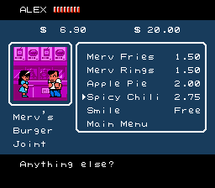
Dialogue trees are a hammer. Game designers use it on nails, screws, bolts, drywall, etc.
Case in point: NPC shopkeepers where the player just wants to make a financial transaction. Lengthy dialogue trees slow the player down without adding value. It also trains the player to spam “A” to get to the next choice, so that they ignore your dialogue later when it matters.

Slide 12
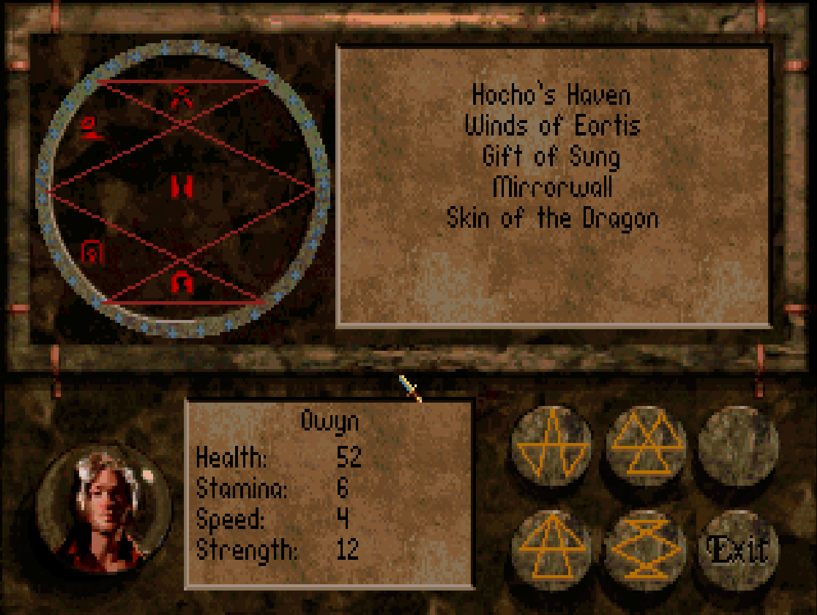

Design Considerations
What form will your dialogue system take?
There is a direct one-to-one mapping between dialogue systems and narrative systems. Anything you do with one of these, you could do at a different scale with the other. Each can look to the other for inspiration.
Linear
Branching
Threaded
Parallel

Slide 13
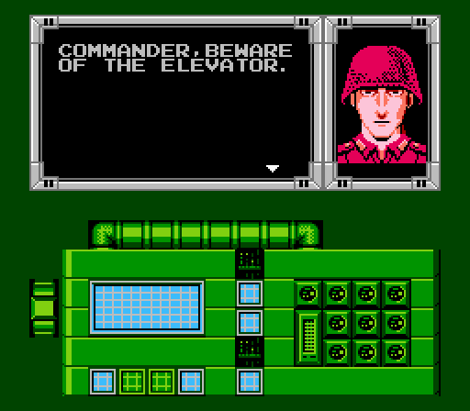
When using dialogue trees, use them judiciously. Not every NPC interaction has to involve choices. For example, there are no choices at all on this slide and you’re still reading it. If you save dialogue trees for appropriate situations, that lets the writers focus their efforts on the most impactful conversations without diluting their effectiveness.

Slide 14
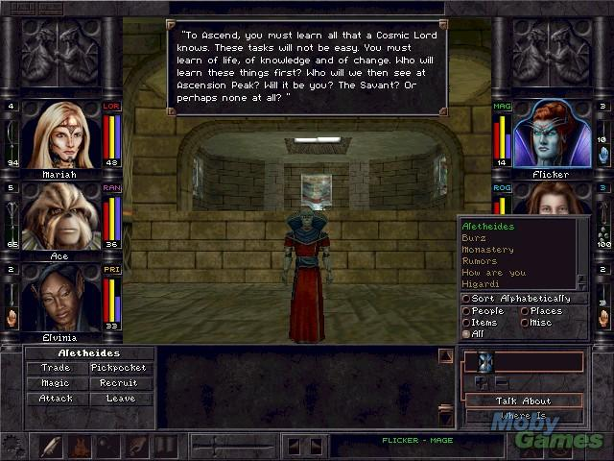
If humans can read and enjoy a book, they are capable of enjoying a paragraph of text in your game, provided it’s well-written. Players don’t hate non-interactive dialogue because it’s not interactive, but because it often isn’t worth reading. Think of cut scenes: as long as they’re used at the appropriate times and worth watching, they don’t need Quick Time Events to keep the player engaged. Don’t neglect the importance of good writing!
Note: good game writing is often pithy, short and entertaining.

Slide 15
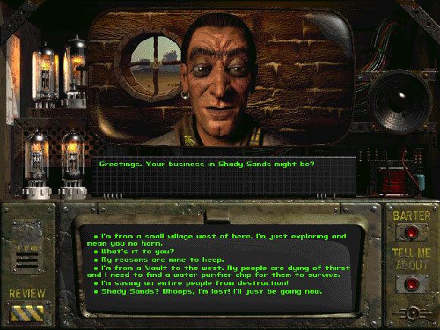
What are some tradeoffs to consider in the design of your dialogue system?
[Fault tolerance] At one extreme, a player can lose the game by making a wrong choice. At the other, a player can “fail” a conversation without any consequences.
[Variety] Human interactions aren’t deterministic – they depend on a person’s mood, context, and many other things outside of someone’s control (or knowledge). They also aren’t completely erratic, however, as humans generally have some basic justification for their actions.
[Opacity] The less muddy (and more transparent) the underlying dialogue system, the more the game encourages the player to be manipulative rather than empathetic. Consider the desired player mindset.

Slide 16
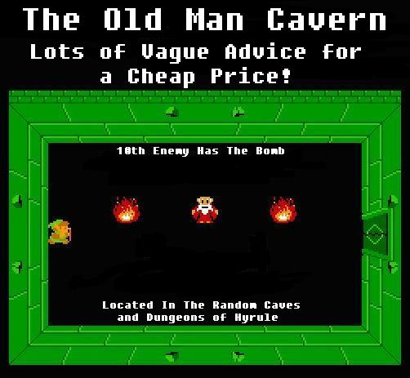
Some experimental ideas
Additional emotional nuance: choosing a facial expression or emoji in addition to a dialogue choice could expand the possibility space (e.g. saying something seriously vs. sarcastically).
Conversation choices as an inventory system: learn new things to say as you progress through the game.
Two-way conversations: create a context where the player is rewarded for watching, listening, and then interjecting at the right moment.
Fan-fiction as untapped relationship model: have the player interact with the hero they love, rather than having them be that hero.

Slide 17

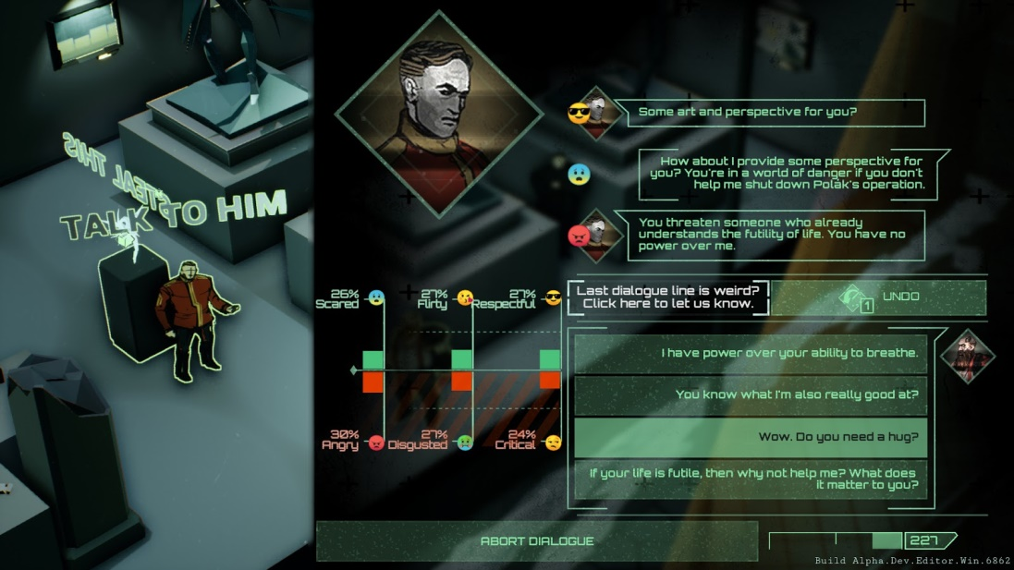
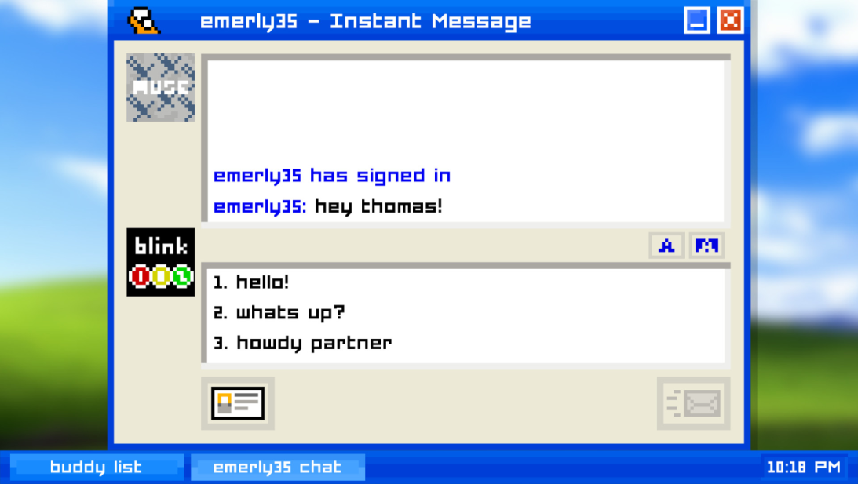
Case Studies
Emily Is Away: differentiates itself through the interface, where the player chooses a response and then “types” it out longhand. There are also moments where the player selects one option and then the PC changes their mind and self-censors to change the response, e.g. by hitting a virtual Backspace key.
All Walls Must Fall: each conversation choice advances towards an endpoint on three separate meters. The conversation ends when one of the meters maxes out, at which point the NPC lets the PC go in peace (if they “won”) or raises the alarm and attacks (if the player “lost”). System is highly manipulative, which fits the fiction of the game (PC is infiltrating a heavily guarded area using a combination of combat and social engineering).

Slide 18
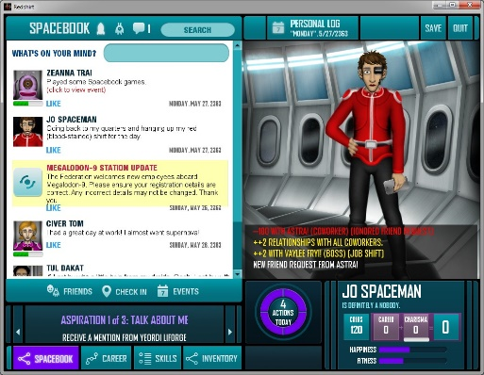
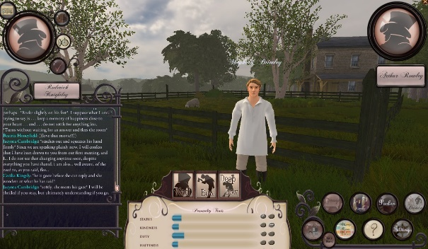
Case Studies
Ever, Jane: set in the world of Jane Austen’s stories, this MMO focuses not on combat, but on gossip, dinner parties, and role-playing. Player-player interactions (through text chat) are emphasized. Interactions with NPCs allow the player to choose whom to gossip about, whether to be truthful or lie, and about what topic (such as money, romantic status, etc.) – either for the purpose of helping or destroying the social status of yourself or others.
Redshirt: uses a social media interface to allow the players to interact with a variety of procedurally-generated characters. The goal of the game is to manipulate other people through social media, schmoozing your way into promotions and out of getting sent on dangerous missions.

Slide 19
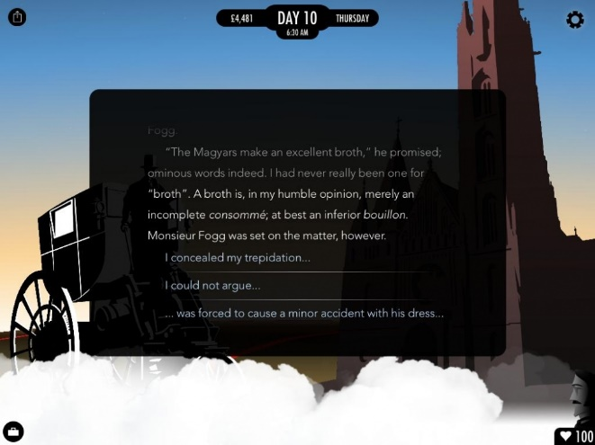
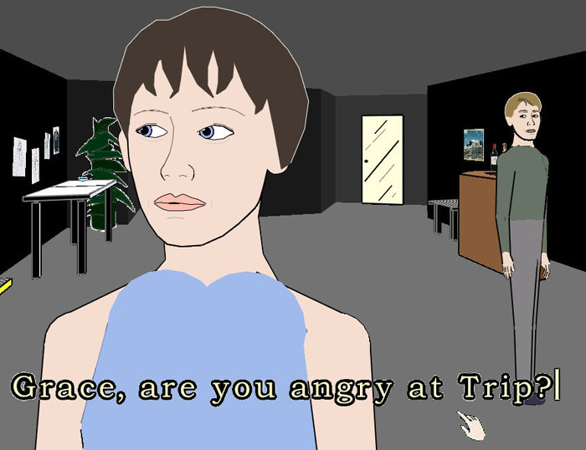
Case Studies
Façade: The player can type sentences which are scanned for keywords, and the NPC dialogue is chosen based on a reaction to any identified words. Additionally, the game is played in real time: NPCs will continue talking to the player (and each other) even if the player does nothing, and the player can get interrupted if they take too long to type something.
80 Days: Presents entirely different interfaces for conversation (pictured above) and transaction, so it doesn’t undermine the effectiveness of conversation trees by putting them where they aren’t needed. Also stands out for its high-quality writing compared to many other games.

Slide 20
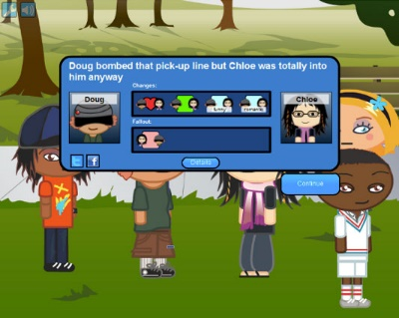
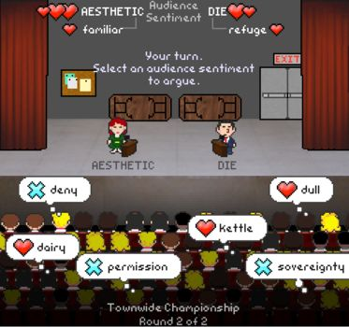
Case Studies
Argument Champion: not so much a simulation of conversation, as of debate through word association. Players argue in favor of their topic or against the opponent’s by drawing favorable associations between their word and those that the audience likes, or unfavorable associations between audience dislikes and their opponent’s topic. Word associations and word clouds provide interesting potential for conversation systems in games that is mostly unexplored.
Prom Week: characters have a variety of actions they can take with one another, and a web of interrelationships that determine the results of an action. Each character can have platonic or romantic feelings towards anyone else, as well as having a history of being friends (or enemies) and a history of past actions with the other person and their friends/enemies.

Slide 21
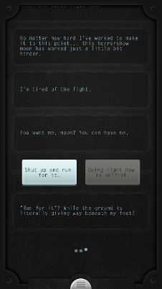
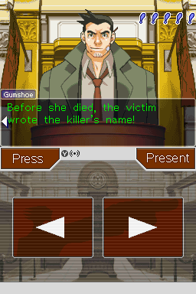
Case Studies
Lifeline: mobile game that uses a text-based interface that fits in the fiction of the story (you’ve crash-landed on an alien moon, most of the crew is missing or dead, and your only means of communication is through a text interface between the player and the main character). The story plays out in real time, with notifications being sent to the player throughout the day.
Phoenix Wright, Ace Attorney: when questioning a witness in court, the player not only has a set of dialogue options, but can also press for more information on each, or present evidence to contradict the witness’s testimony. The dialogue options in court are themselves treated something like inventory items, which are collected prior to trial during the investigation. Investigations also have the ability to question witnesses and show them evidence to get new responses from them in similar fashion.

Slide 22
Tools and Design Patterns
Modification to the typical dialogue tree: add context, and history within the conversation.
Context: instead of each choice leading to a fixed set of other choices, have each choice enable or disable other choices as a direct result of choosing it, in addition to the NPC response. The choices available to the player at any given time is the set of choices that have been enabled and not yet chosen. Thus, asking questions about a particular topic may open the door to probing deeper into that topic, and learning a particular piece of information may invalidate some other choices that would then be removed since they would no longer make sense.
History: allow conversation choices to modify variables – for example, tracking how intimidated an NPC is that you’re interrogating. Allow the effects of choices to branch conditionally based on these variables: if you move to accuse the NPC of murder, they’ll only confess if Intimidation > 10, otherwise they’ll respond with a flat denial; and different additional dialogue choices get added or removed to the list in either case.
This type of conversation is marginally harder to code and much harder to write (as you have to consider not just each individual conversation choice, but all possible paths through the conversation – it’s no longer a tree, but rather a graph structure). But it feels much more natural and realistic, since the player’s conversation choices and the NPC’s responses are always context-sensitive and make sense within the flow of a dialogue interaction. Modern text-based CYOA games use these techniques a lot, but they haven’t gained traction outside of that niche.
Do you know why you’re here?
I have no idea, I’ve been out at work all day, I came home and you arrested me.
We found a body in your bathtub, would you know anything about that?
Wait… really? Just what are you saying, that I killed somebody?
START
Know whose fingerprints we found on the murder weapon? Yours.
I… you can’t be serious.
[Intimidate +3]
Okay, I know it looks bad but there’s more to the story you don’t know…
END
You’re going down for Murder One unless you start cooperating, you understand?
Intimidate > 10?
Look, I didn’t do it and you have nothing. This is over, get me my lawyer.

Slide 23
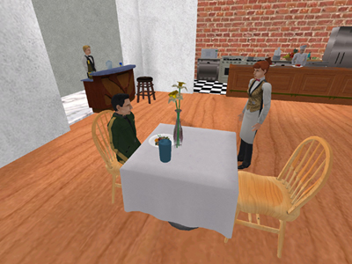


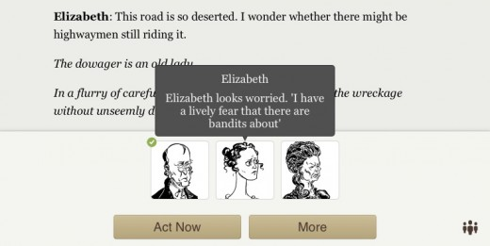
Tools and Design Patterns
Once upon a time, some game developers at MIT made a virtual restaurant simulation, with one human roleplaying a patron and another the waitstaff. They then took over 10,000 playthroughs and pattern-matched to find that the vast majority of these were similar enough that either role could be realistically simulated with an AI or a reasonably-sized set of dialogue options. It was a proof-of-concept that you can use a large sample of human conversations to develop convincing in-game dialogue.
The researchers later co-founded GiantOtter, a conversation-bot-as-a-service company that hires improv actors, gives them a scenario and starting point, and then lets them do a few dozen takes in order to fill out the tree.
Spirit’s Character Engine provides an interesting model for character dialogue:
Each NPC has a set of knowledge about the game world (including the PC, other NPCs, locations, items, etc.) that can be updated as it learns more.
NPCs are also given personality and emotional traits that determine the general tone of how they’re likely to react to a player.
Dialogue is done through natural language processing. Imagine a Google Translate plug-in that didn’t just analyze the meaning and translate to a new language, but that looked at the meaning in the context of the game world and formulated a response.
Versu is an NPC system meant for use in Interactive Fiction games. Each NPC is modeled as its knowledge of the game world plus emotional state. It then exposes this state of mind to the player who can make decisions based on this information, and the NPCs themselves also make similar decisions, giving the AI-controlled characters a sense of agency that is lacking in typical dialogue trees.

Slide 24
Additional links you may find helpful:
More ideas for experimental dialogue systems: https://www.gamasutra.com/blogs/BobbyLockhart/20171107/309121/5_Radical_Ideas_for_Dialogue_Systems.php
Example of a player choosing the point of view of the story rather than modifying the story itself: https://www.geekwire.com/2017/interview-filmmaker-steven-soderbergh-bends-rules-tv-movies-mosaic-app-hbo/
Forum thread on making dialogue in games inherently fun: https://www.gamedev.net/forums/topic/657677-ideas-to-make-dialogue-funengaging/
A concept for linking narrative and dialogue systems together: https://www.gamasutra.com/blogs/RonNewcomb/20110719/89854/Reusing_Planning_Trees_for_Interactive_Dialogue.php
A psychological theory about how people interact in social situations, in ways that could form the basis for a conversation system: https://en.wikipedia.org/wiki/Politeness_theory

